Slide 1
Back To Blue - Art Bible
Marianna Messana

Slide 2

Value Statement
Back To Blue is a single player game about cleaning up the pollution in the reefs of the Caribbean. The art style is very minimalistic and child friendly. With thick outlines around the player character making them stand out from the background. As the player picks up the pieces of trash the environment lightens as it begins to be purified turning from a dark grimy sea to back to blue.

Slide 3
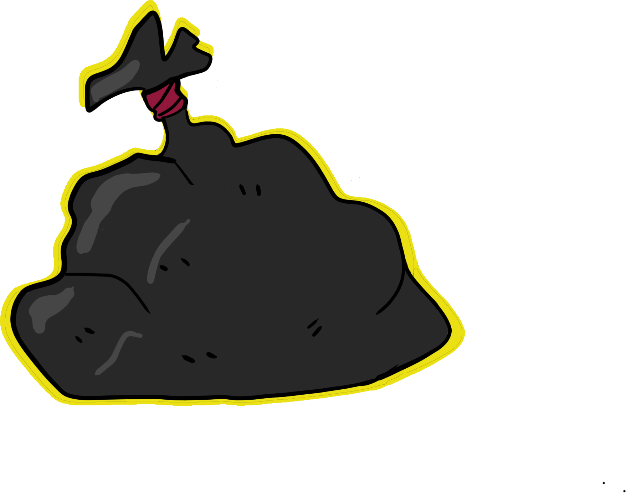
Visual Direction
The art style features lineless environment assets, with thickly lined character assets. The style will be rather painterly yet simple, colored with a textured brush effect to give definition without too much detail. It gives the essence of the object without having too much defition.

Slide 4
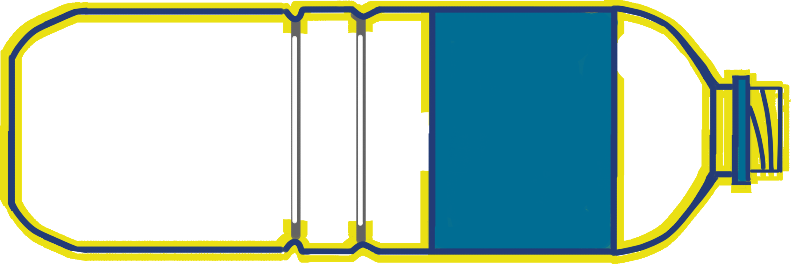
UI
Most of the UI will be integrated into player feedback (sound and visuals) minimizing screen clutter. Allowing the player to focus on the game. When hooks drop they leave a shadow. Basic tutorial bubbles appear when a player is doing something new for the first time. There is a main menu as well as a level select.

Slide 5
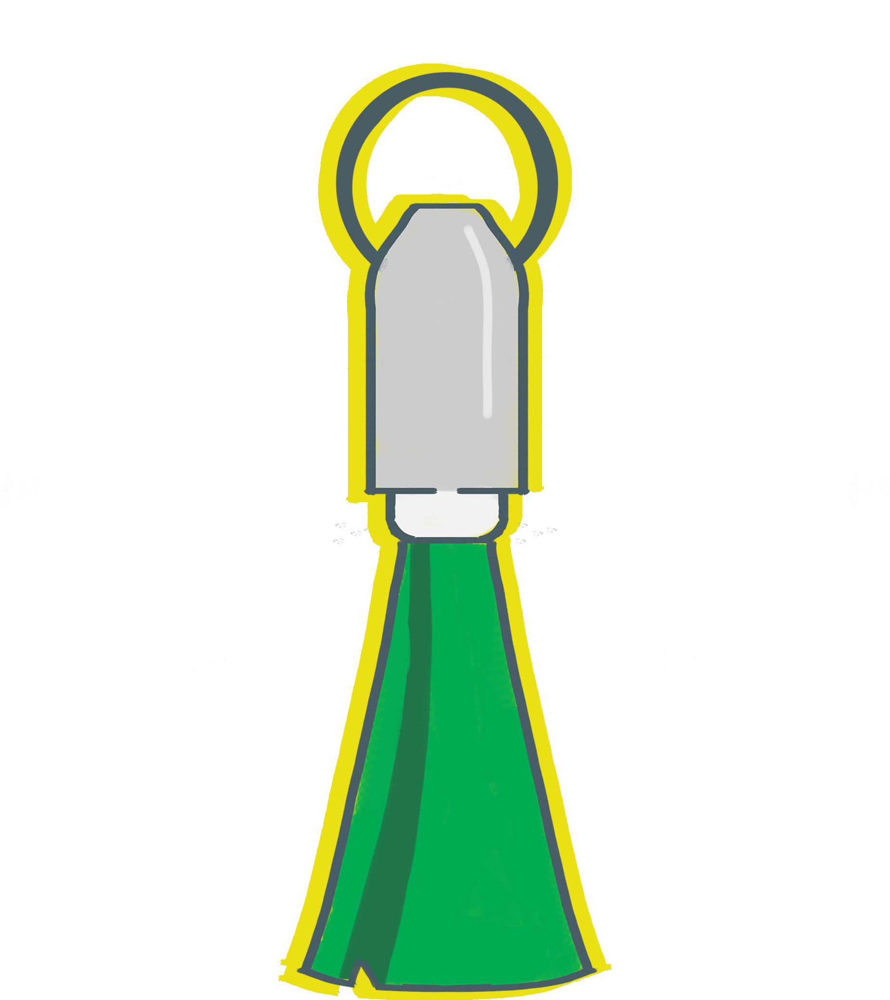
Implementation
Art assets were created in a 16:9 in a mix between Adobe Illustrator and Photoshop. Assets were named simply for what they were and with each iteration named the same to allow for easy implementation. Then added to the repo.

Slide 6
Color Pallet
Colors are fairly simple with browns being used for before being cleaned, and then the blues being after being cleaned. The green can be used for either before cleaned it will be used as algae, and for plant life after being cleaned.

Slide 7
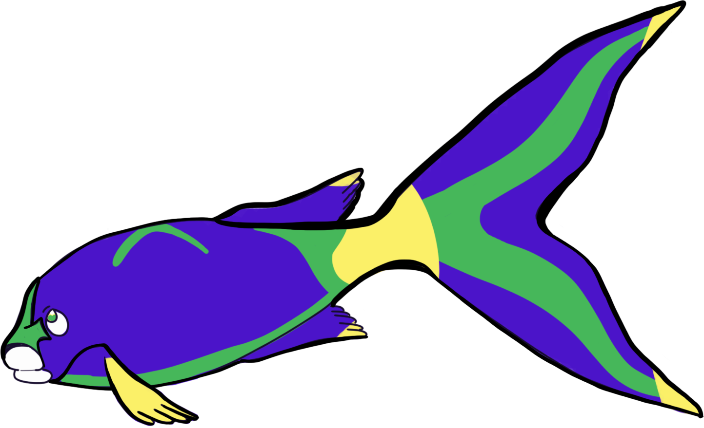
Creole Wrasse (Player Character)
Our wrasse has very thick black outlines with minimal bright colors to really make them stand out against their environment.

Slide 8
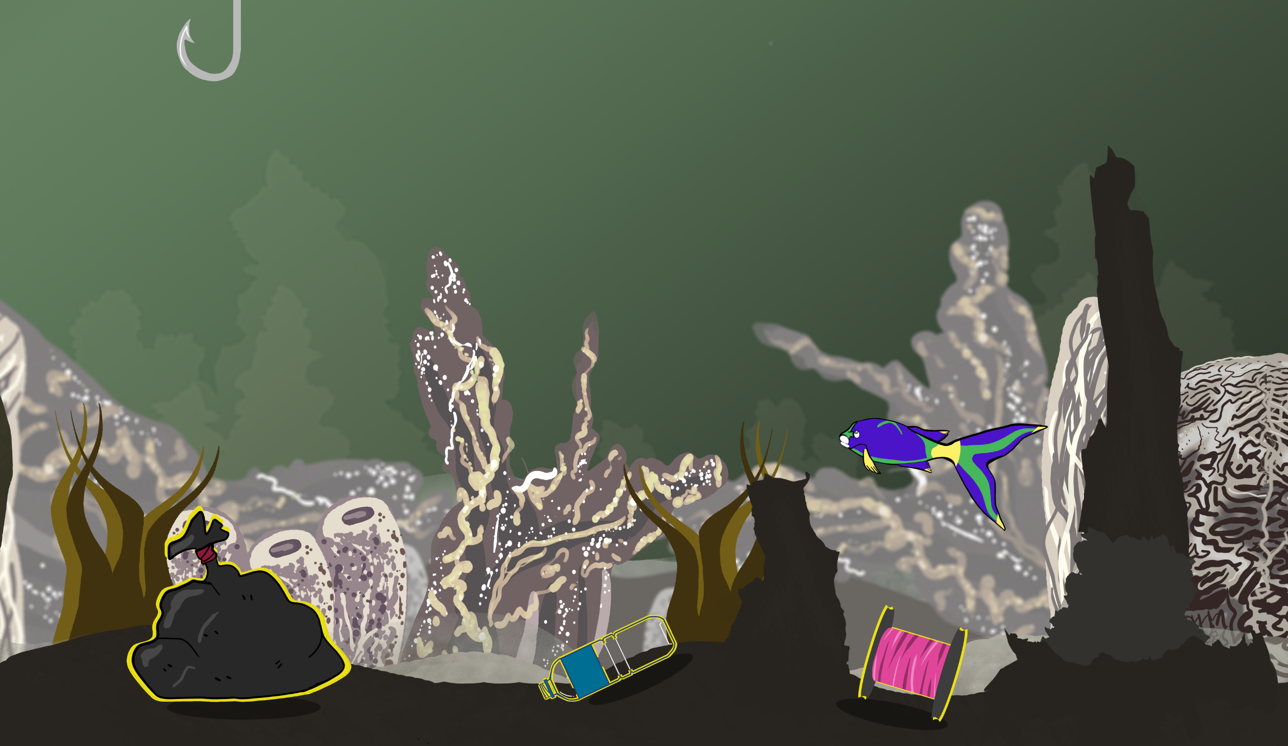
Environment Art
All interactable objects are outlined in yellow to give the player direction. Darker foreground elements contrast against the saturated background elements that were also blurred.

Slide 9
Environment Art
The grass is layered to allow for the player to cross through it. Colors are very bland to allow for the interactibles (including the player) to stand out.

Slide 10
Environment Art
Patterns are chaotic but are meant to represent the beauty and intricacy of the ocean’s natural living organisms. Simple purposeful brush strokes to give the essence of the object in the evironment.

Slide 11
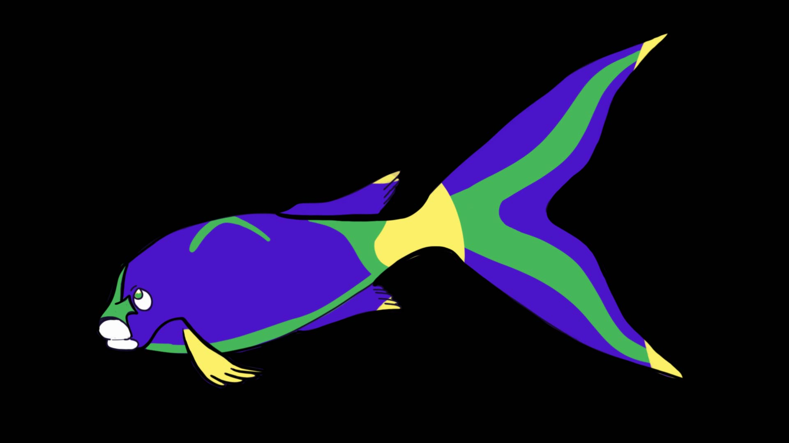
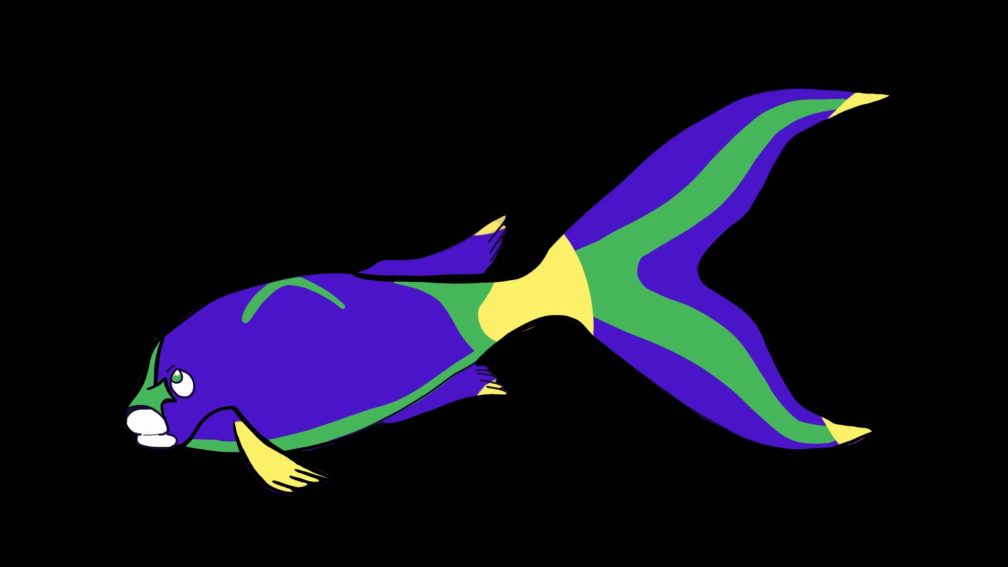

Player animation
Some frames from the animation. It was done in illustrator using the puppet tool to move the fins. The puppet tool allows for more fluidity than most 2D animation tools.

Slide 12
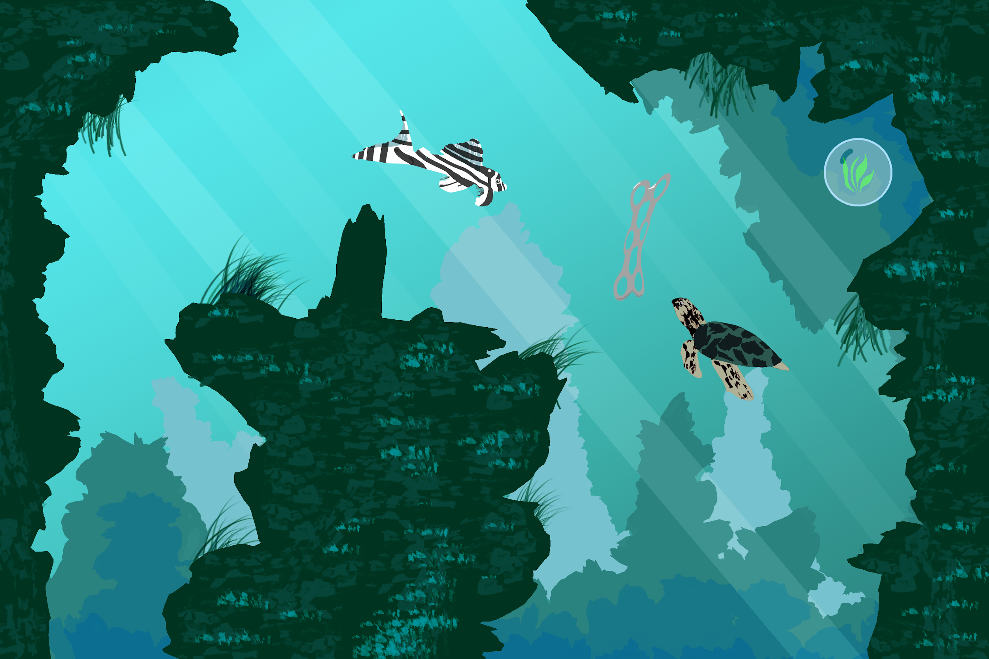
Back To Blue
Back To Blue is more visually complex than our other two concepts. While the player is solving the puzzle the world has a green tint to it. Darker shapes in the foreground act as the player bounds.

Slide 13
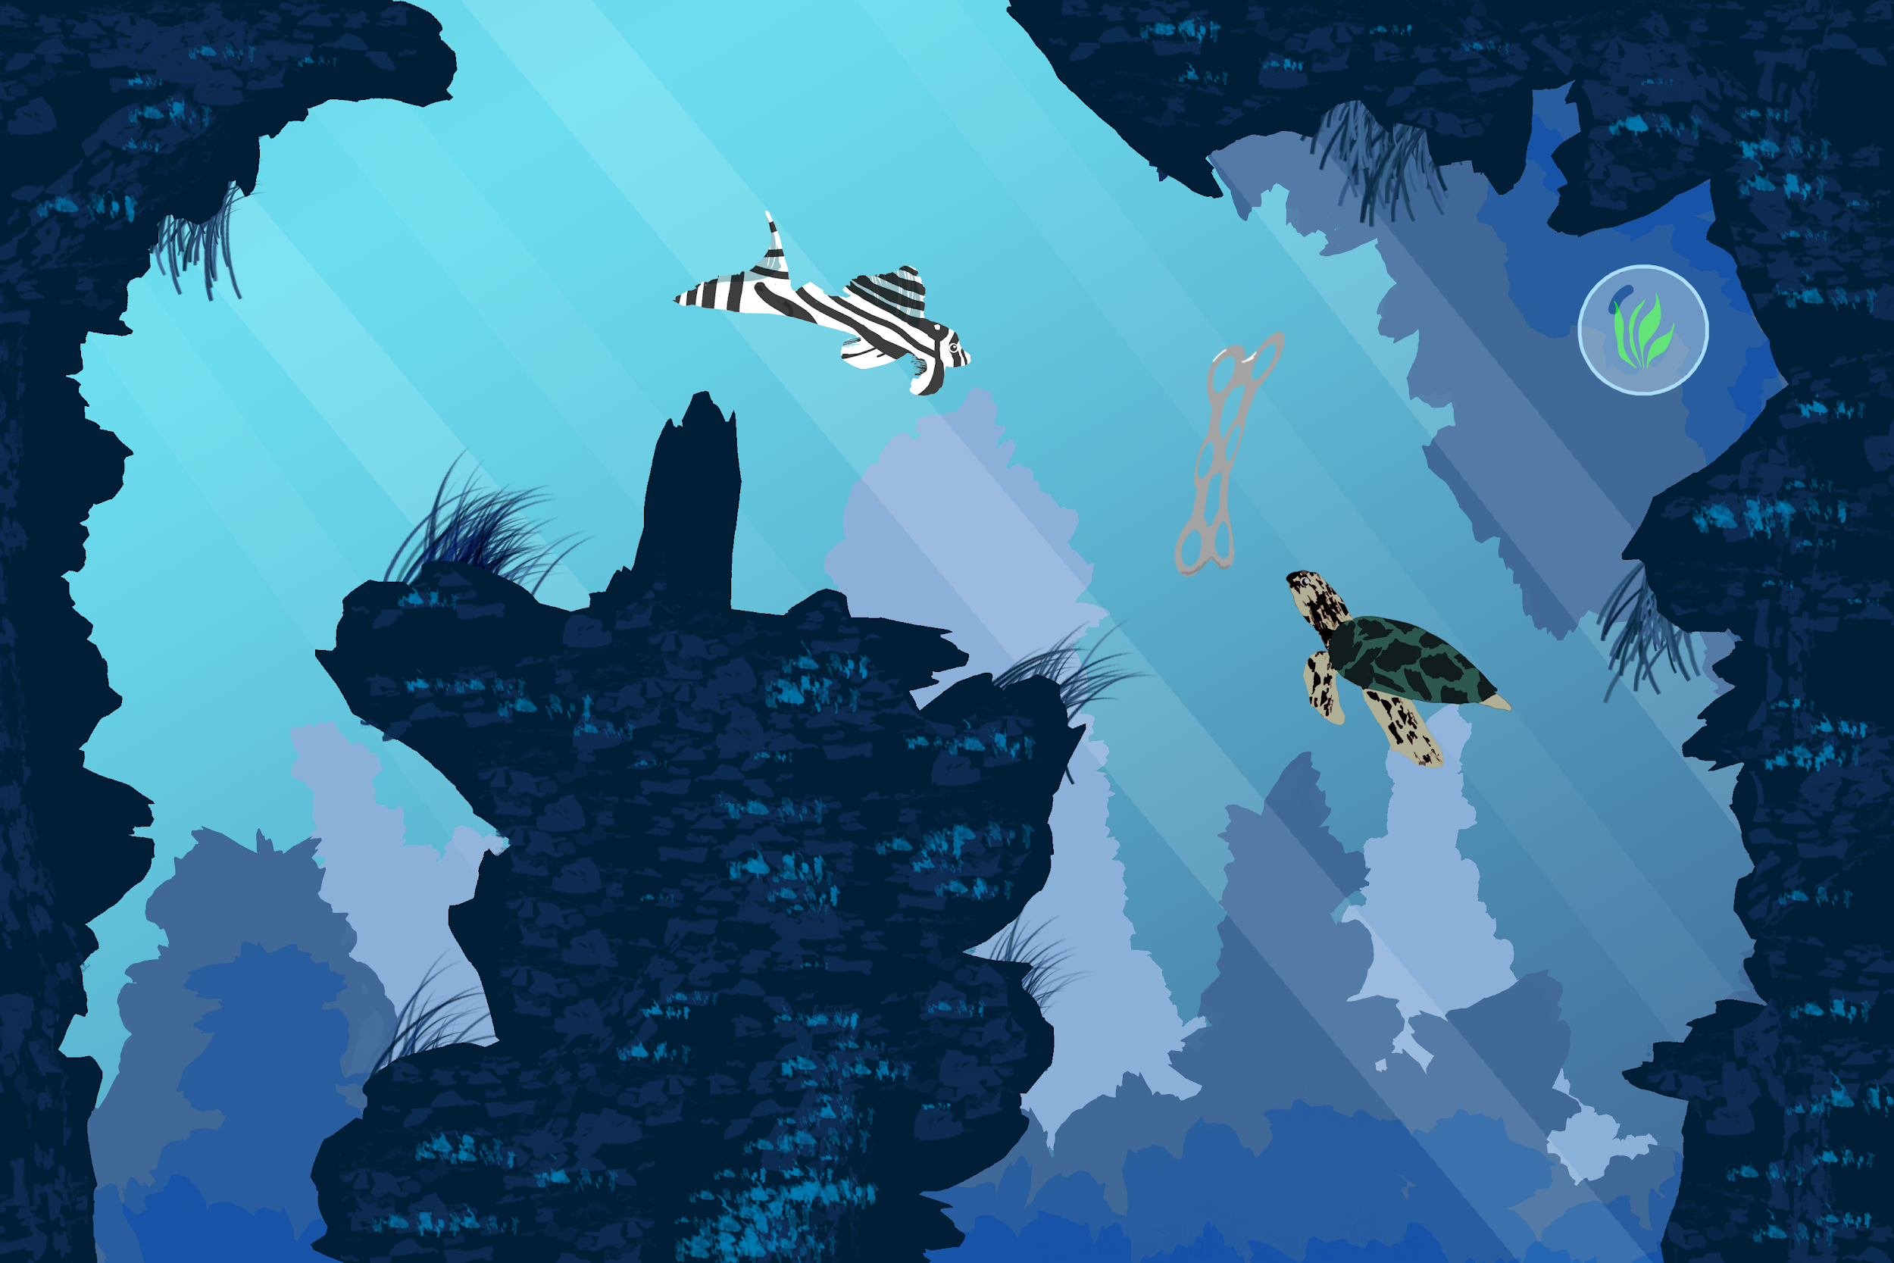
Back To Blue
Lighter rock formations in the background allow a sense of depth, some more midtones will be added. For the greener scene the colors will be pushed more to really portray the death of an ocean. A more distinct player character will be added since its current features feel a bit lost.

Slide 14
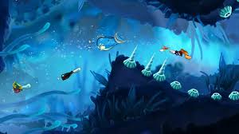
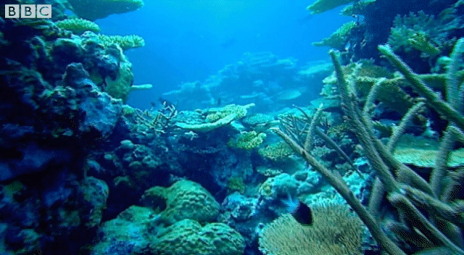
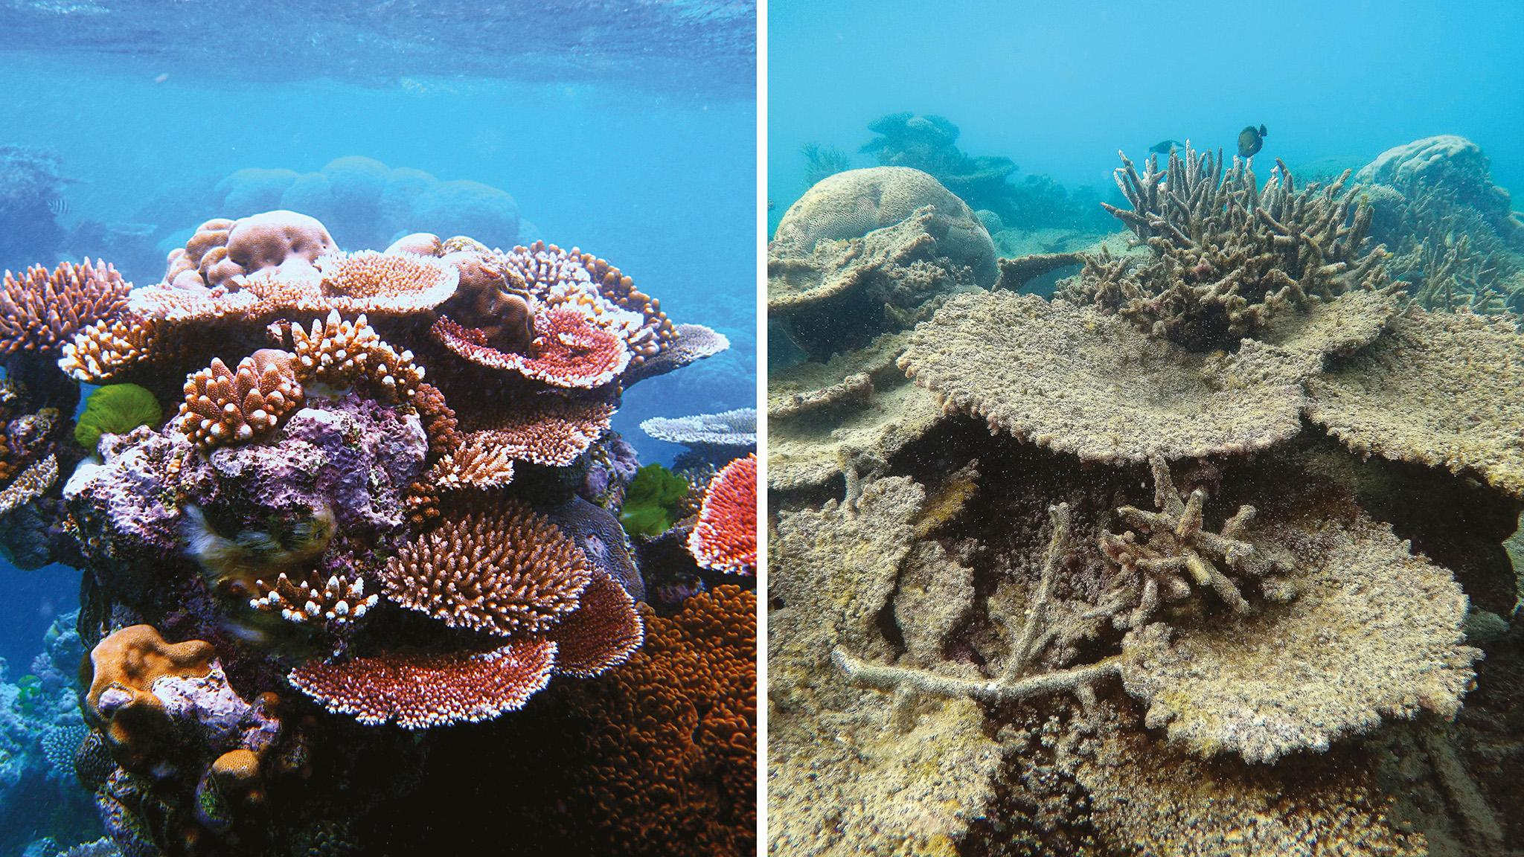
Initial Inspiration For Back TO Blue
Notes:
https://en.wikipedia.org/wiki/Rayman_Origins
https://www.ft.com/content/7954eaaa-c184-11e6-9bca-2b93a6856354
https://giphy.com/gifs/bbc-stargazing-live-3og0IMh7rRNPtNSK9q

Slide 15
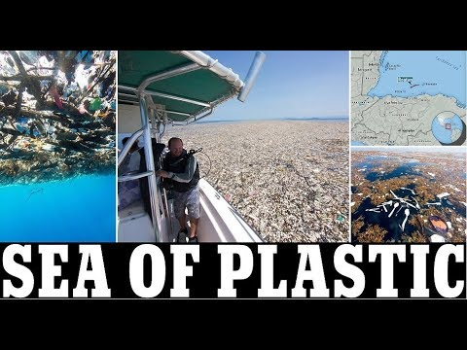
Pollution in the Caribbean
Plastic- lots of floating garbage dumps (Bags, Bottles,Utensils just literally covered in garbage)
Huge amount of fishing ships and the waste that comes from the ships themselves.

Slide 16
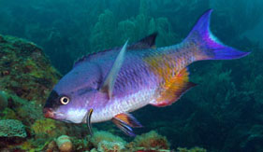
Creole Wrasse (Player CHaracter)
Or known as Sand-reef Wrasses
Western Atlantic & Caribbean
Color Varies
Length - 20cm Depth - 9-25m
Swim a little above the coral reef, only going into spots for food. They have teeth. As they age they change a lot in color and in shape. First to rise last to go to bed.
Notes:
https://www.fishkeeper.co.uk/databank/creole-wrasse
http://www.whatsthatfish.com/fish/creole-wrasse/1589

Slide 17
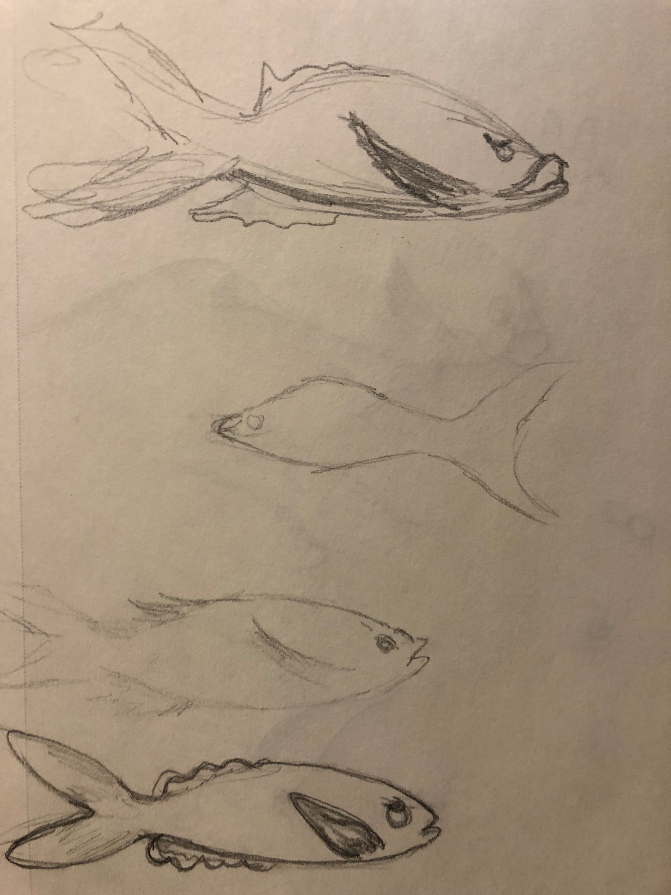
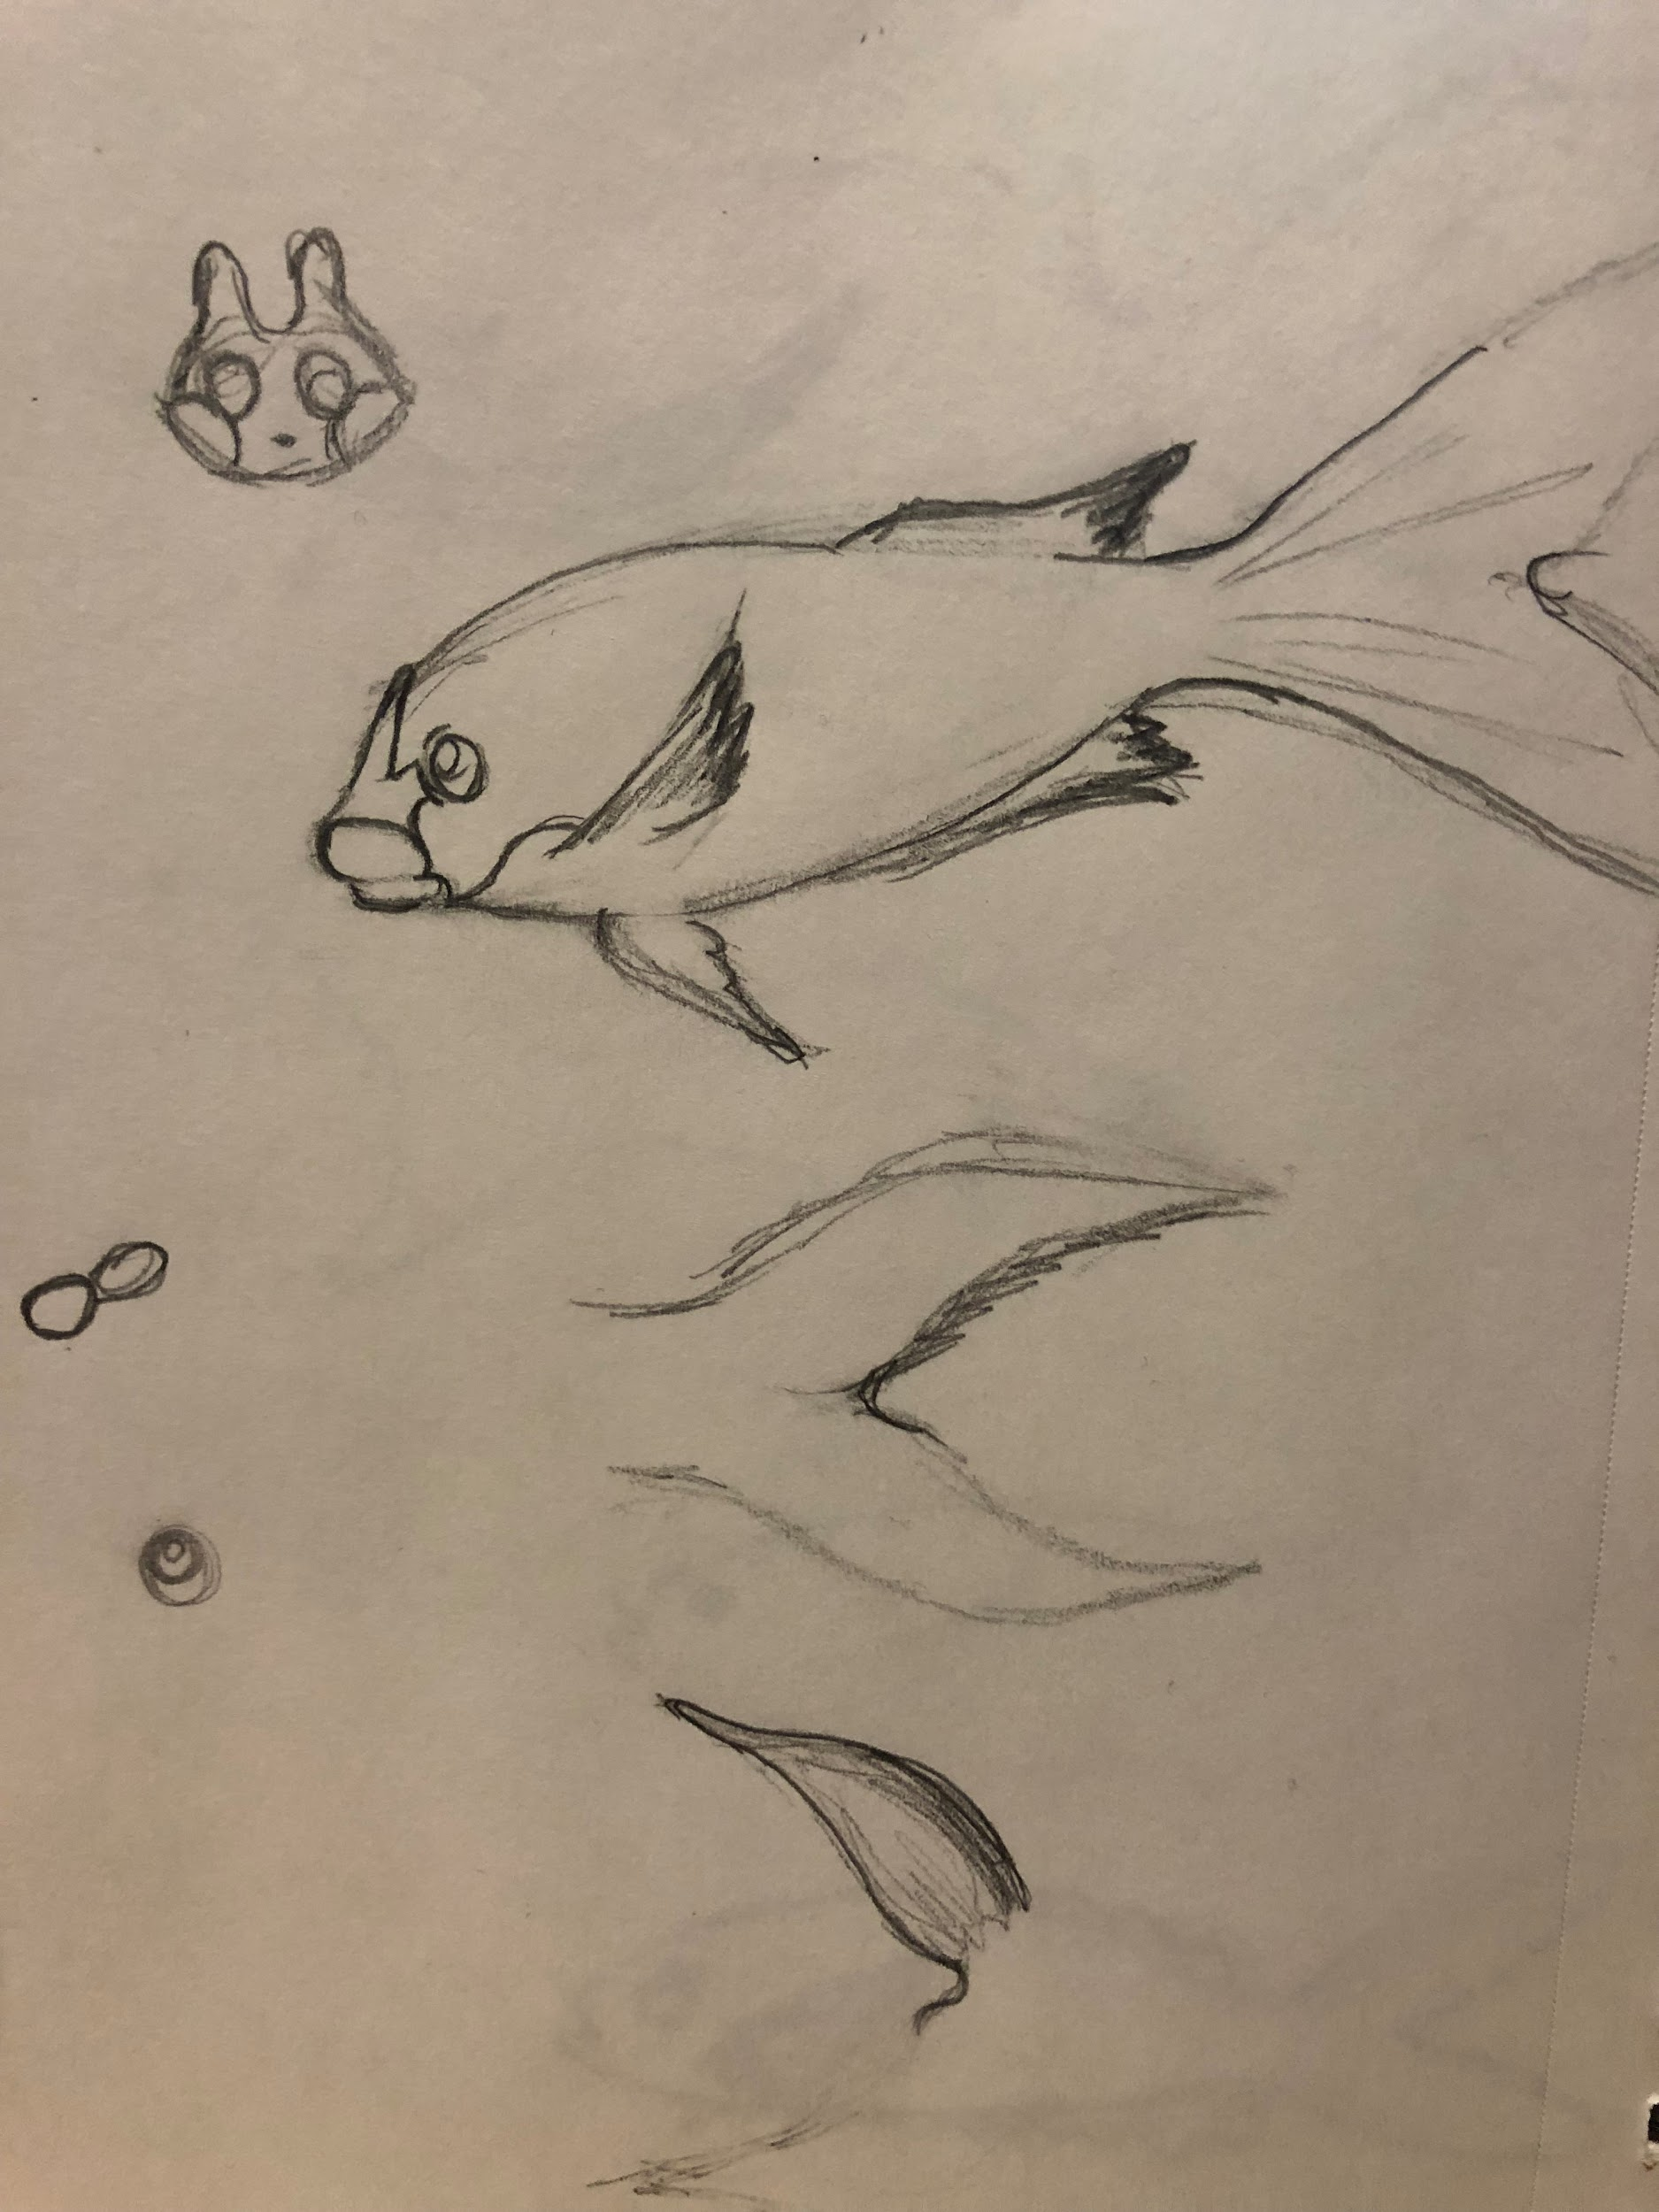
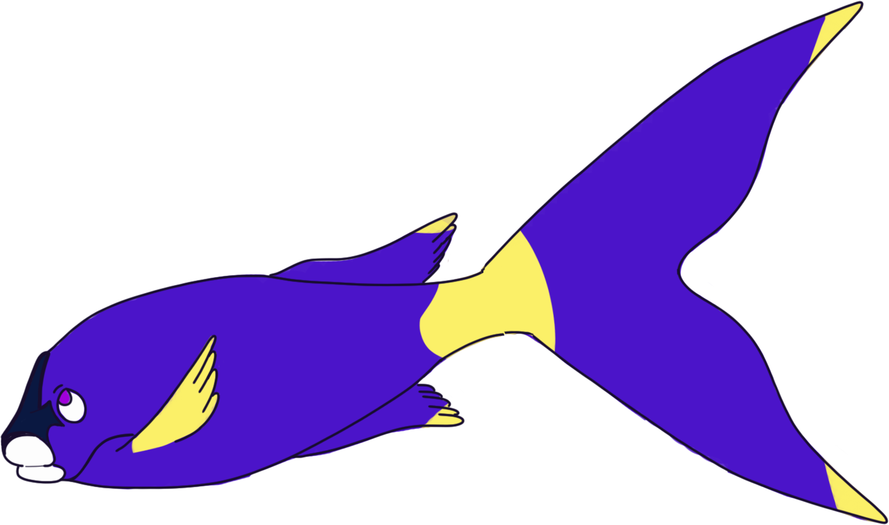
Creole Wrasse (Player Character) Concept Sketches

Slide 18


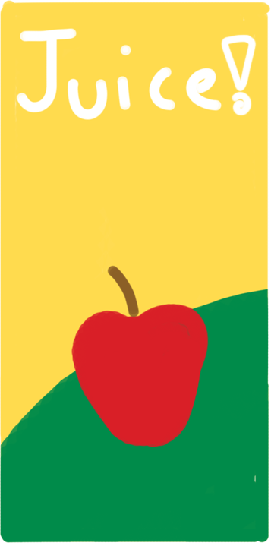



Base Environment Assets

Slide 19
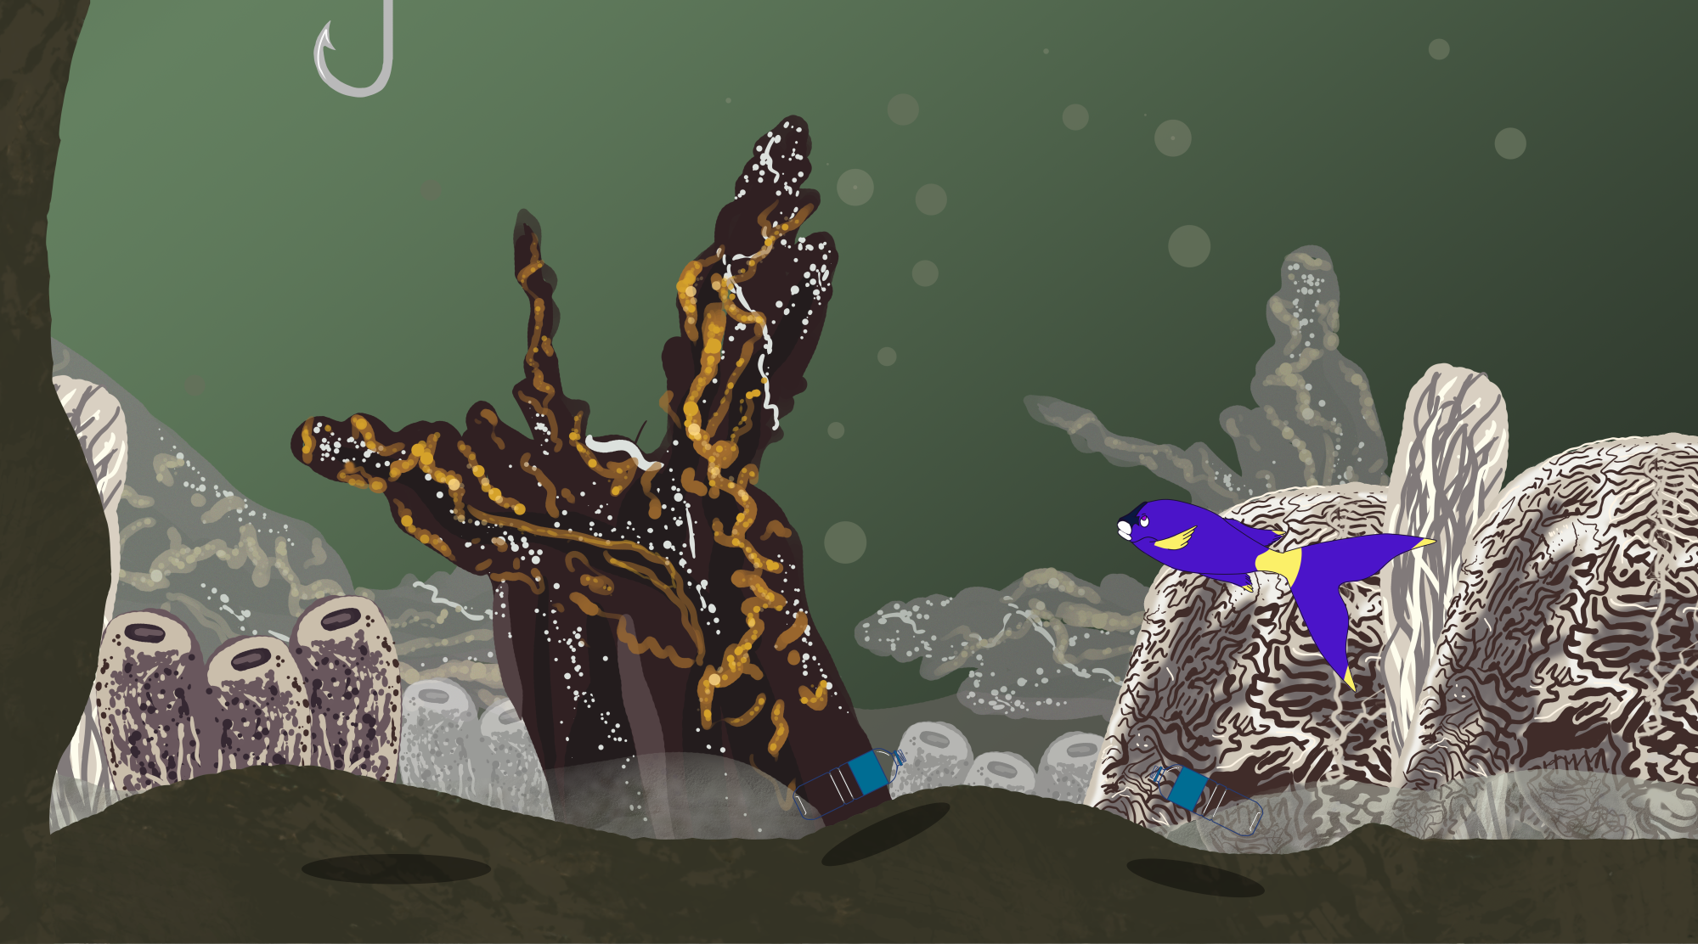
Upgraded Environment Art
New detailed player boarders as well as background assets

Slide 20
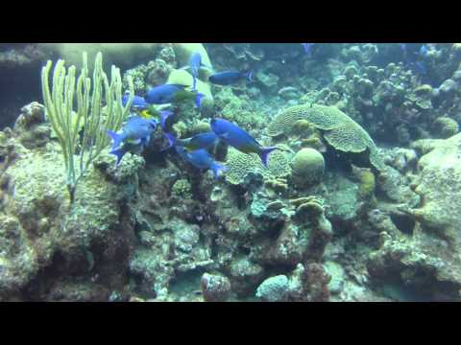
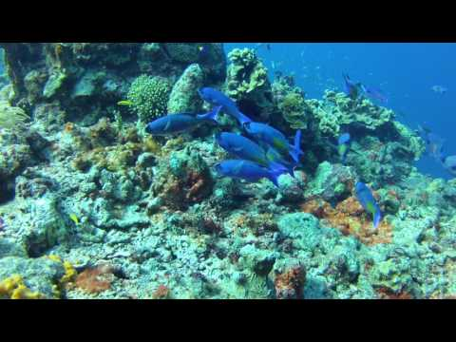
Creole Wrasse (Player CHaracter) Animation Reference
Notes:
https://www.fishkeeper.co.uk/databank/creole-wrasse
http://www.whatsthatfish.com/fish/creole-wrasse/1589

Slide 21
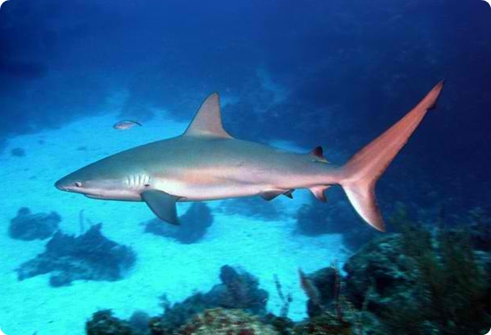
Caribbean reef Shark
Also known as a Reef Shark
Extra back tip to their back fin. Curved dorsal fin, long gills.
10 meters long. White to light yellow. Large eyes and has a small and round snout.
Lives in the Western Atlantic Ocean.
They can purge. Sleep on the ocean floor or within reef caves.
They do a threat dance, essentially a zig zag motion
Notes:
https://www.sharksider.com/caribbean-reef-shark/

Slide 22
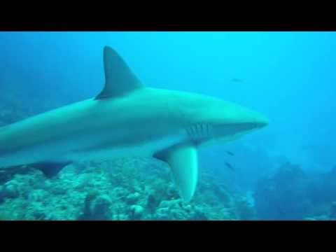
Caribbean reef Shark (Animation)
Notes:
https://www.sharksider.com/caribbean-reef-shark/

Slide 23
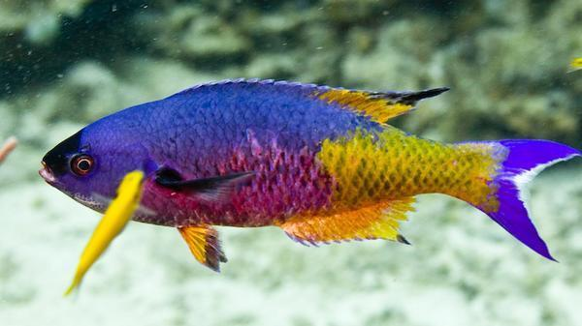
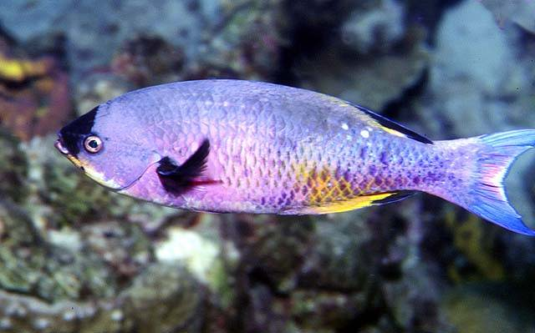
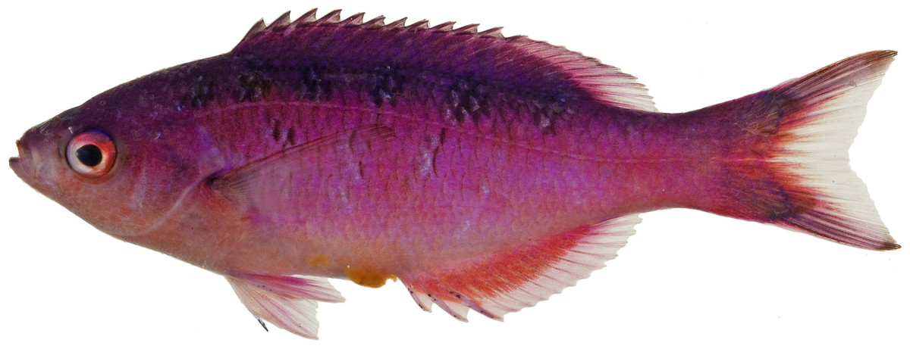
Inspiration: Coral Wrasse

Slide 24
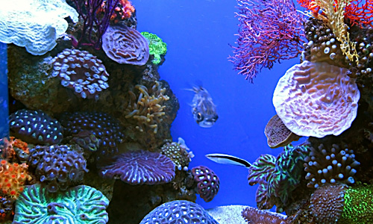
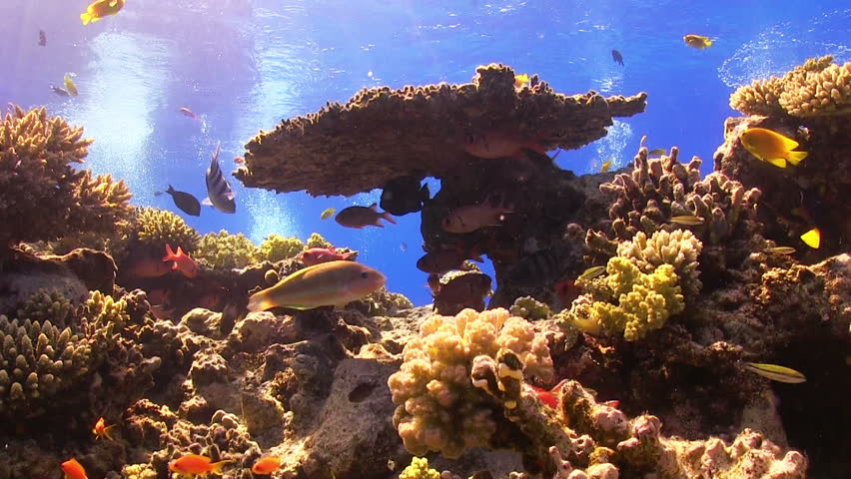
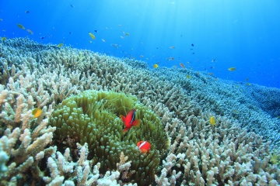
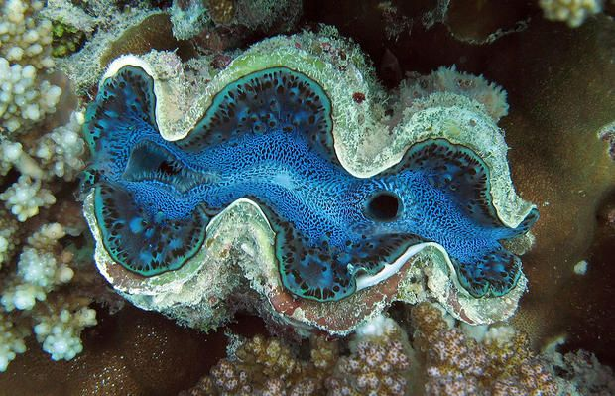
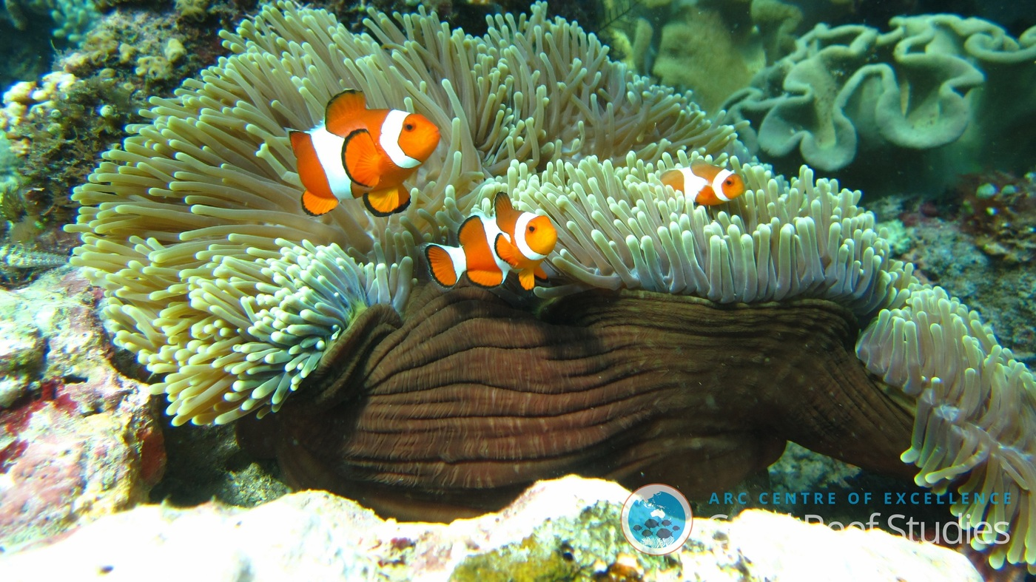
Inspiration: Nature

Slide 25
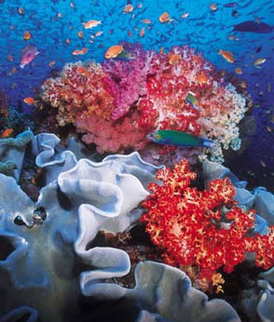
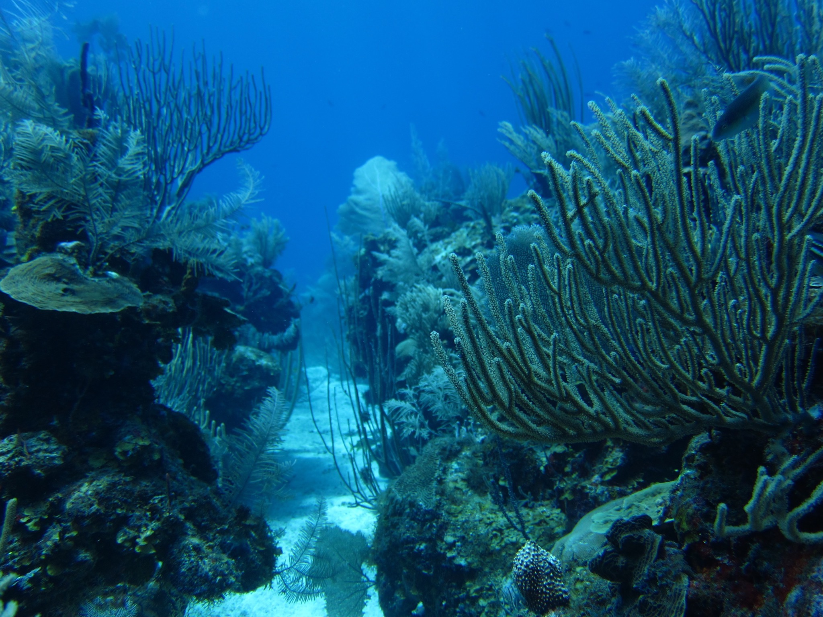
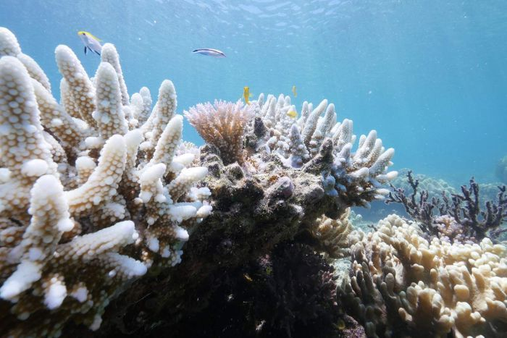
Inspiration: Nature

Slide 26
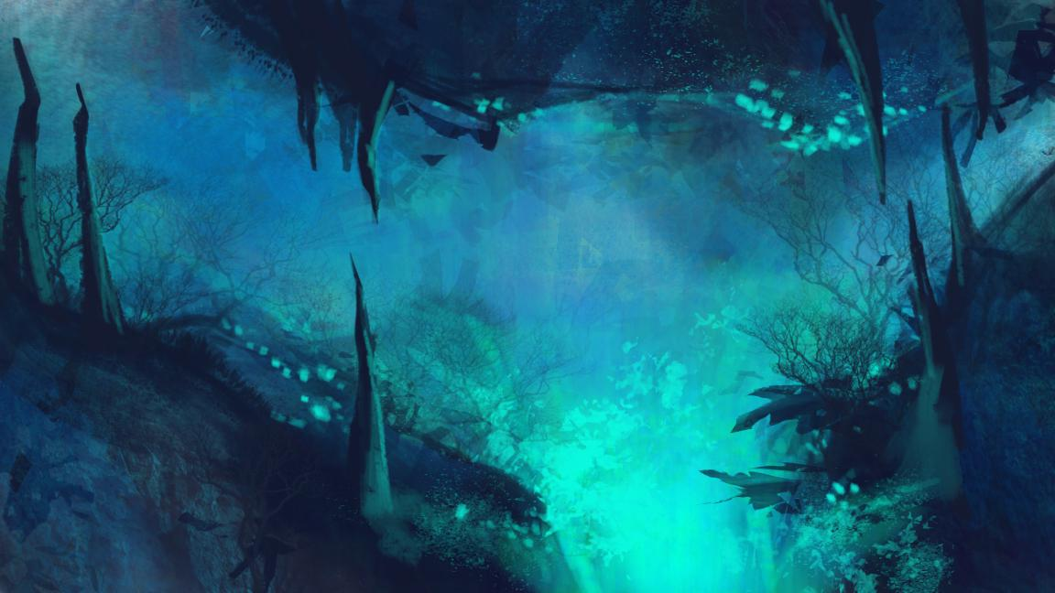
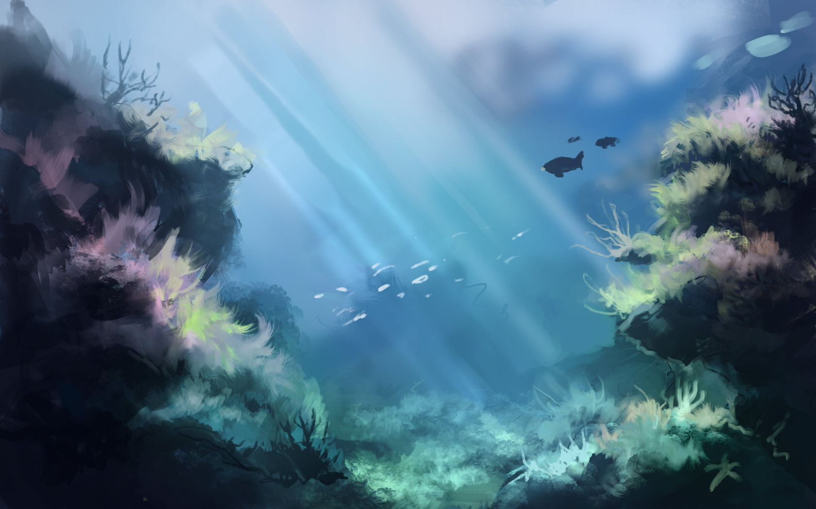
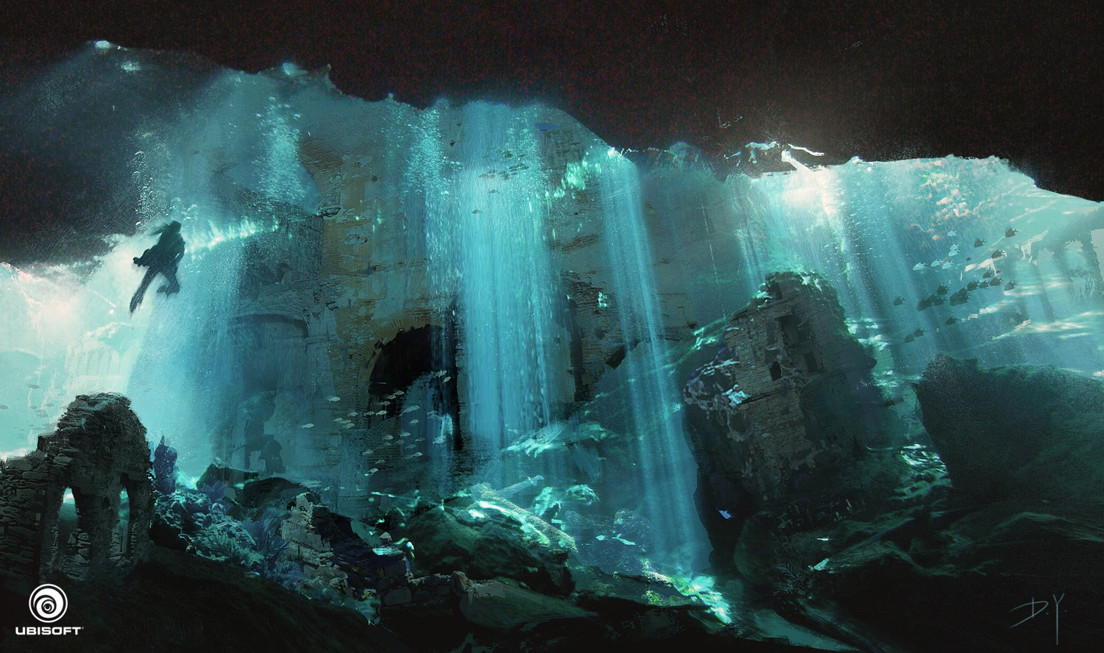
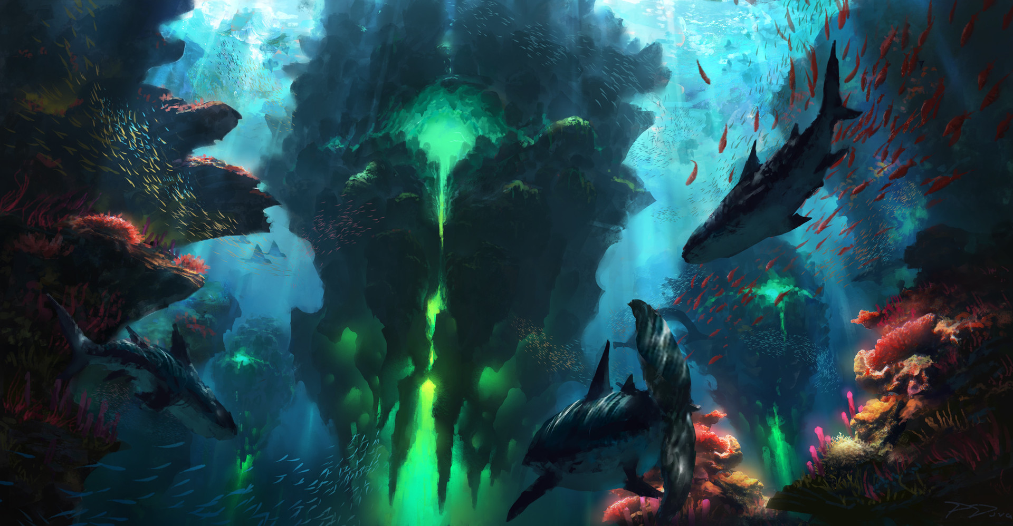
Inspiration: Concept Art (Other Artists)

Slide 27
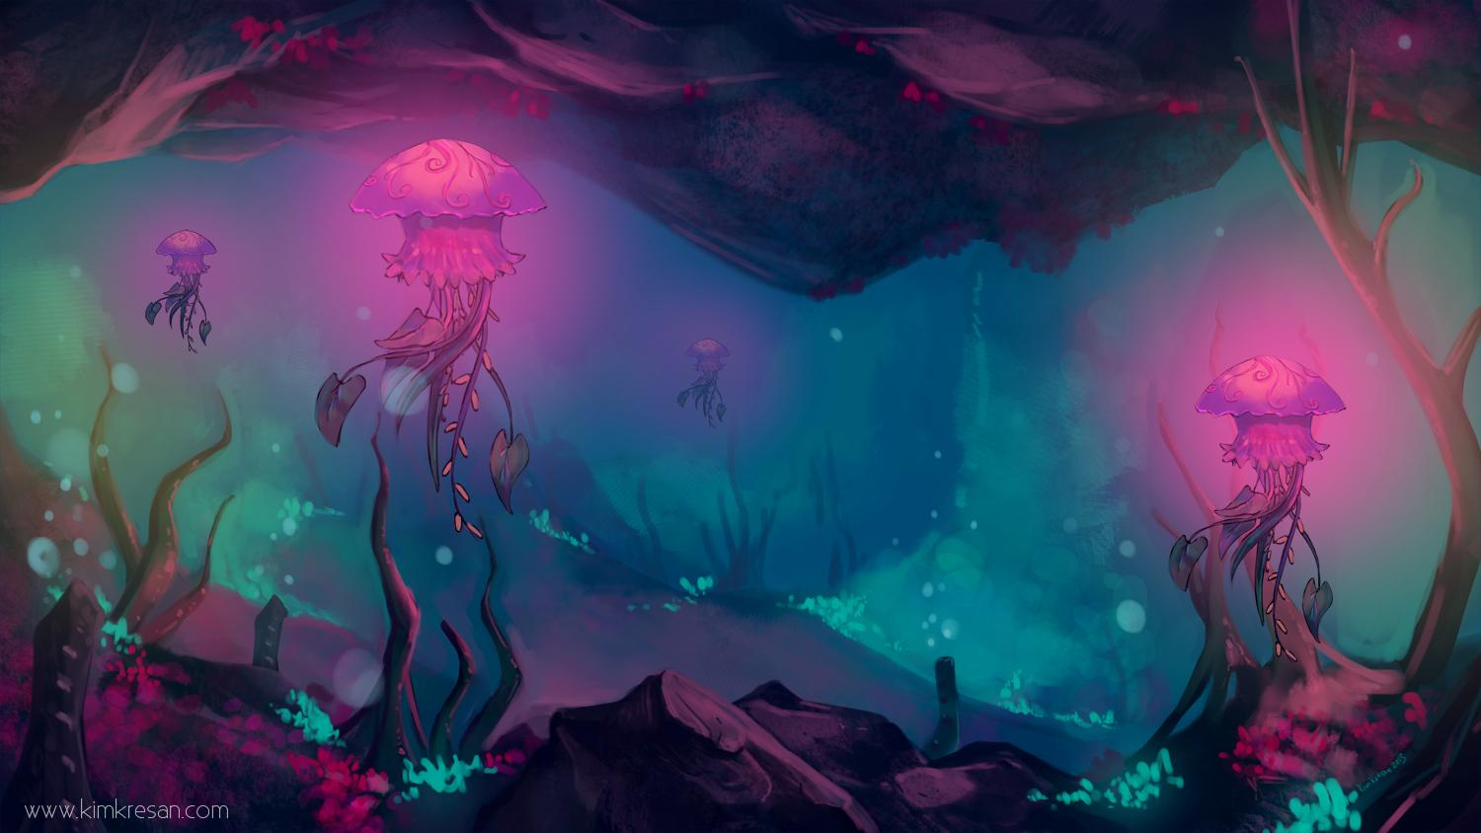
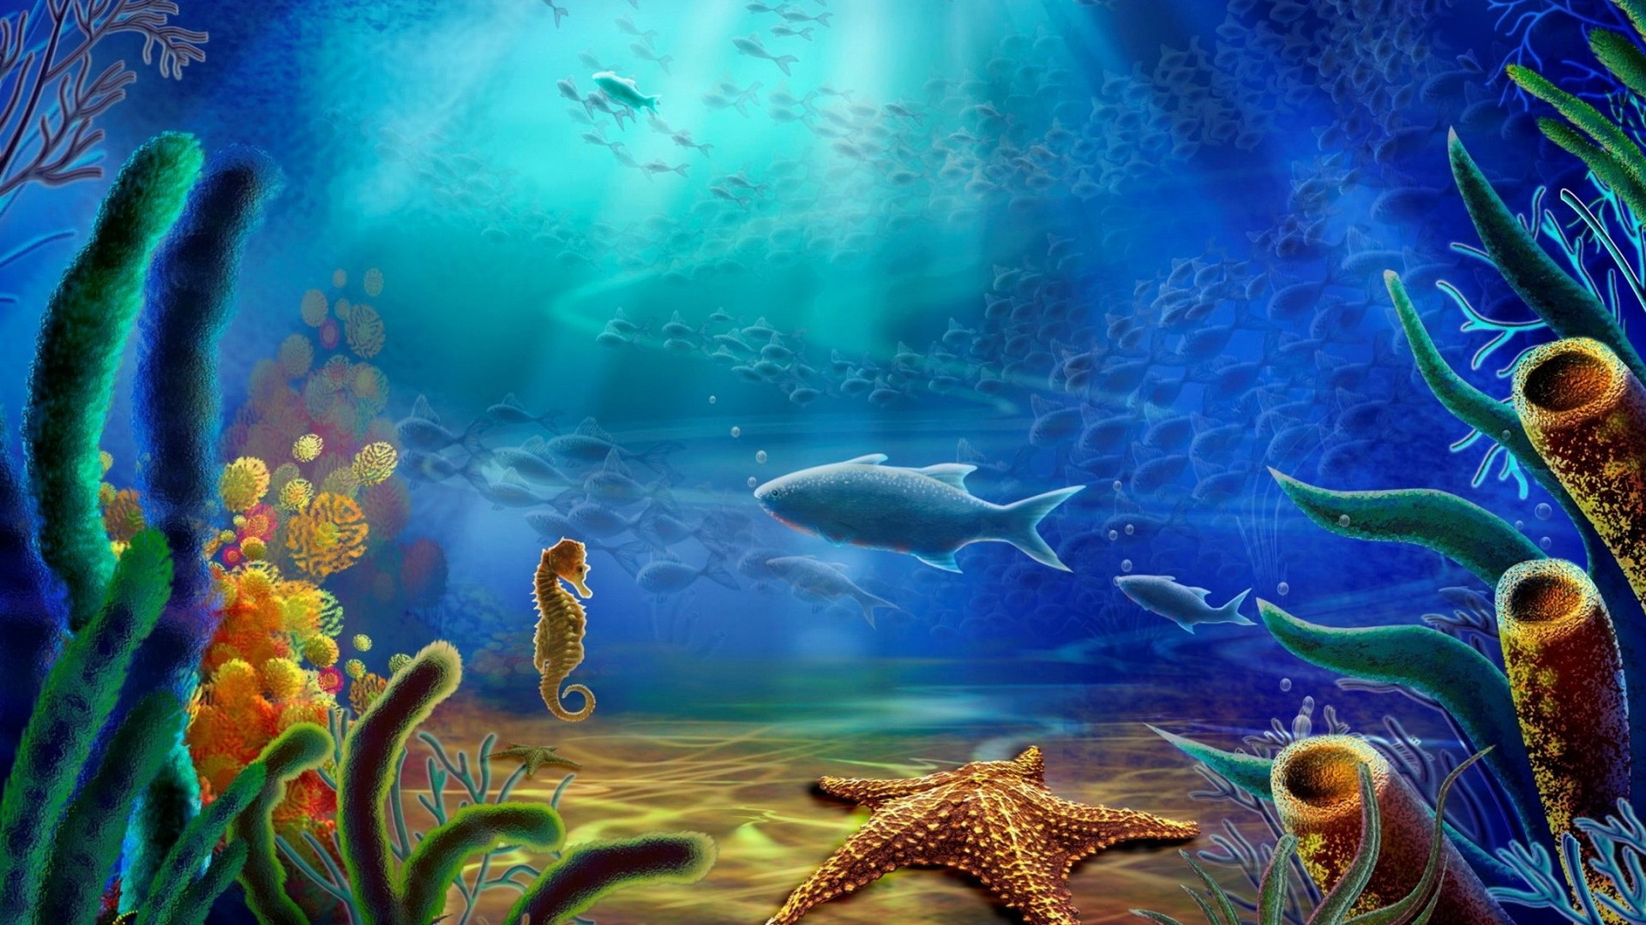
Inspiration: Concept Art (Other Artists)

Slide 28
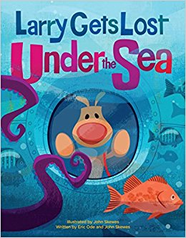
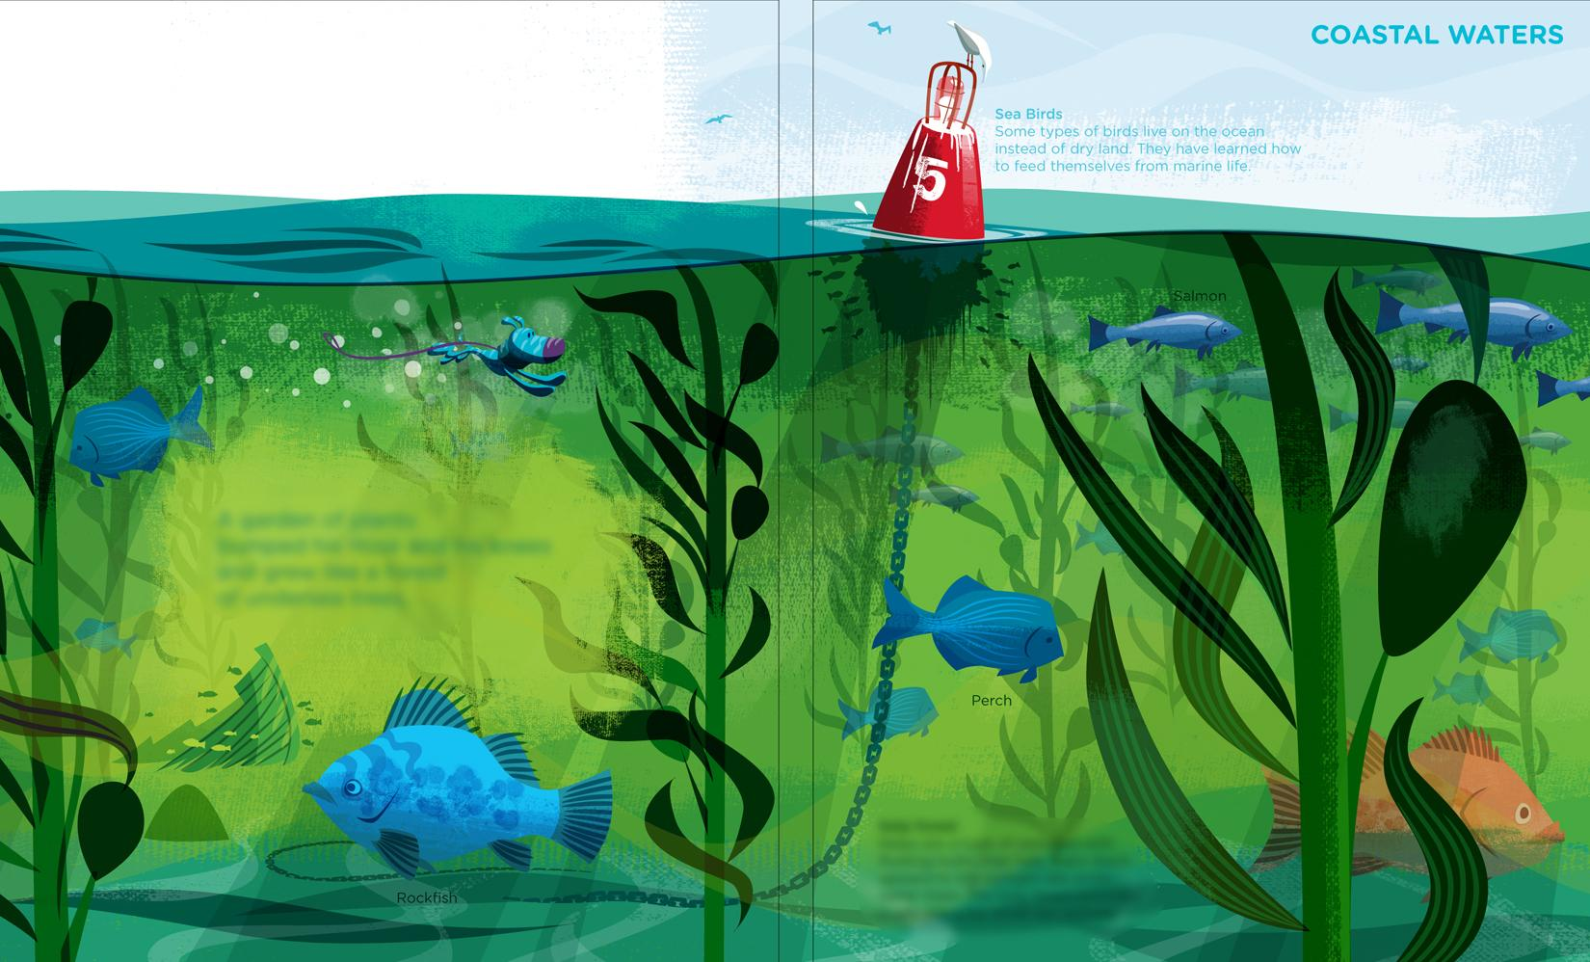
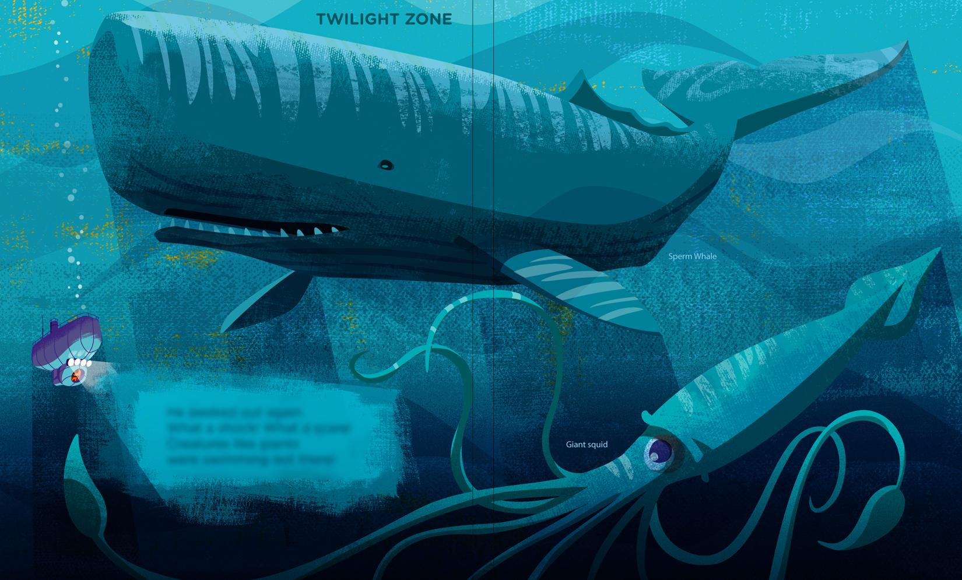
Inspiration: Larry Gets Lost

Slide 29
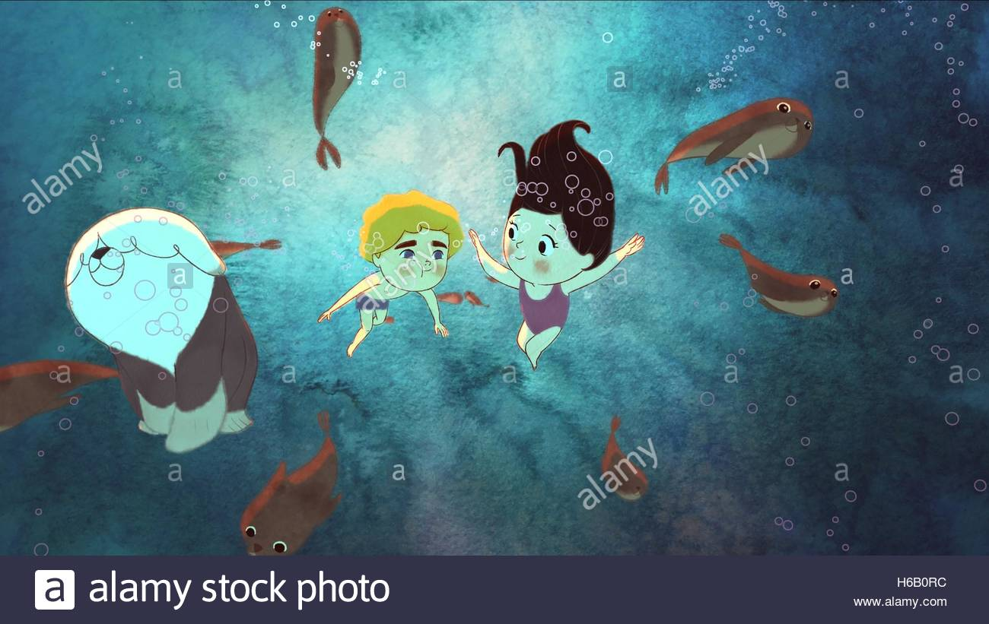
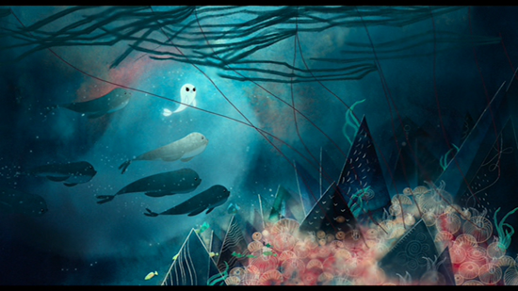
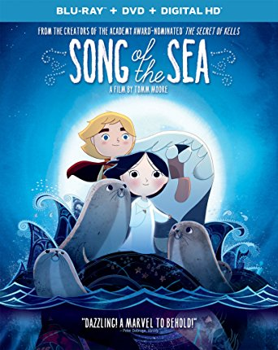
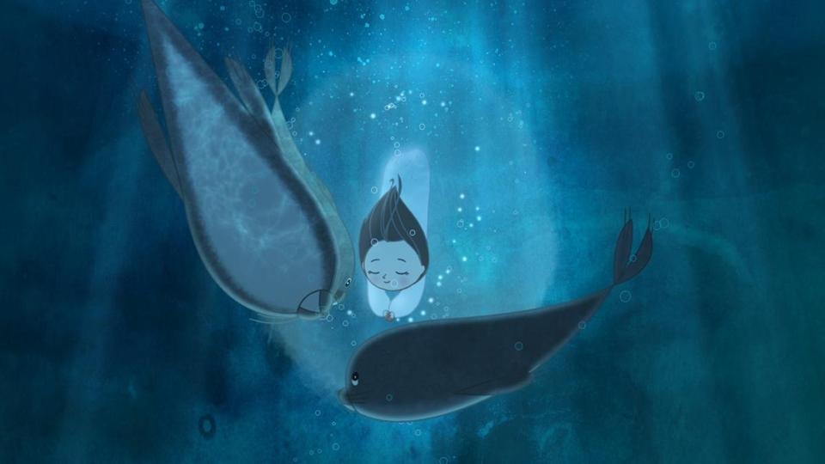
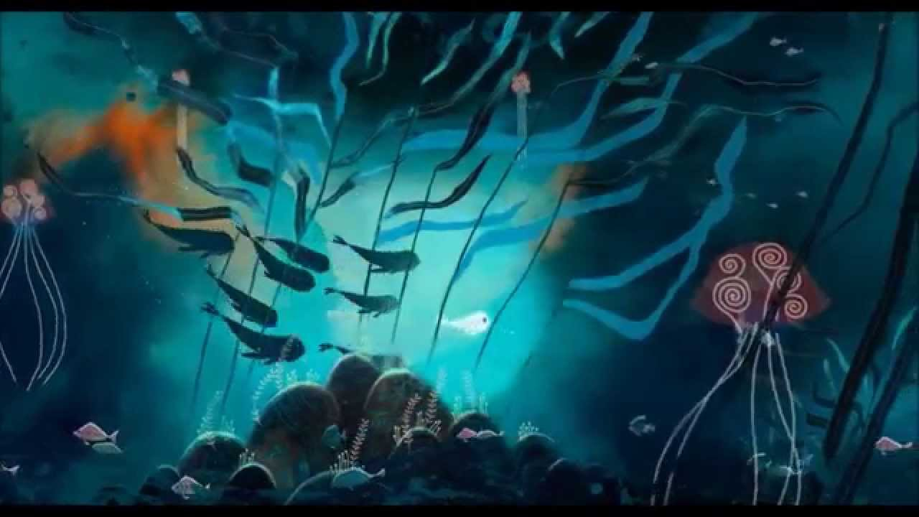
Inspiration: Song Of The Sea

Slide 30
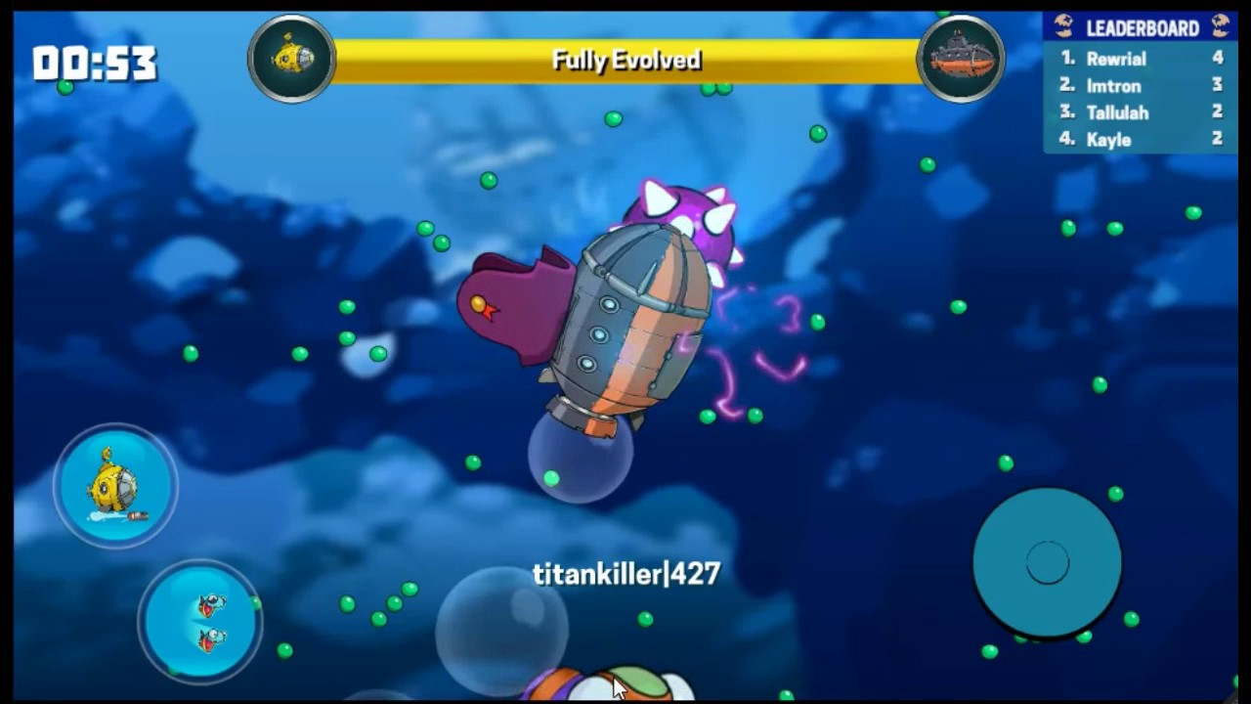
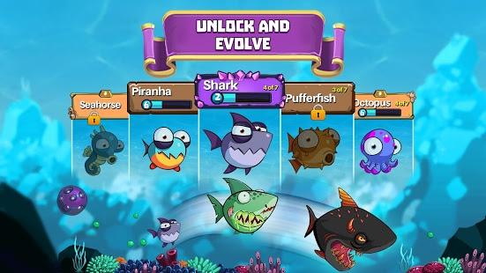
Inspiration: Eatme.io

Slide 31
Things to do for sprint 3
UI
Shark, Larry, beginning animations
Tiliable pieces
Opening pieces
More parallaxing pieces

Slide 32
Other Game Concepts!

Slide 33

Color Collide!
Color Collide surprisingly is not a very visual colorful game. It’s about making color so in the spirit of cleanliness the palette itself is a gray along with simple helpful buttons towards the bottom. It is the player’s goal to create different colors. The game is visually simple due to our target audience.

Slide 34
Color Collide!
Our target audience is meant for young kids, so instead of text I’ve used symbols to represent the different tools they have. Each edge is rounded making it more friendly to the eye. The accent blue to to add some visual interest as well as pull from the calmness the color blue brings. Each piece of UI is large and readable.

Slide 35



Inspirations for Color Collide!
Notes:
https://play.google.com/store/apps/details?id=com.appquiz.educational.games
coolmompicks.com/blog/2014/12/15/coloring-books-for-older-kids-adults-marisa-anne-wendy-piersall/
https://www.youtube.com/watch?v=LcyK6H9Cx8w

Slide 36

BluFoot
BluFoot is another visually simple game to go along with the theme. The game is about a person trying defeat monsters that are essentially parts of a computer virus.

Slide 37
BluFoot
I kept things in the style of a broken computer so a blue screen, text and symbols used as platforms for the player and the different interactions. It definitely needs to be pushed further than this but that is essentially the essence of the game.

Slide 38



Inspiration for BluFoot
Notes:
http://store.steampowered.com/app/405640/Pony_Island/
https://en.wikipedia.org/wiki/Blue_Screen_of_Death
https://www.youtube.com/watch?v=Qb1VvUf21L4

Slide 39
Work CIted
Color Collide- https://play.google.com/store/apps/details?id=com.appquiz.educational.games
coolmompicks.com/blog/2014/12/15/coloring-books-for-older-kids-adults-marisa-anne-wendy-piersall/
https://www.youtube.com/watch?v=LcyK6H9Cx8w
BluFoot- http://store.steampowered.com/app/405640/Pony_Island/
https://en.wikipedia.org/wiki/Blue_Screen_of_Death
https://www.youtube.com/watch?v=Qb1VvUf21L4
Back To Blue- https://en.wikipedia.org/wiki/Rayman_Origins
https://www.ft.com/content/7954eaaa-c184-11e6-9bca-2b93a6856354
https://giphy.com/gifs/bbc-stargazing-live-3og0IMh7rRNPtNSK9q

